Slide 1

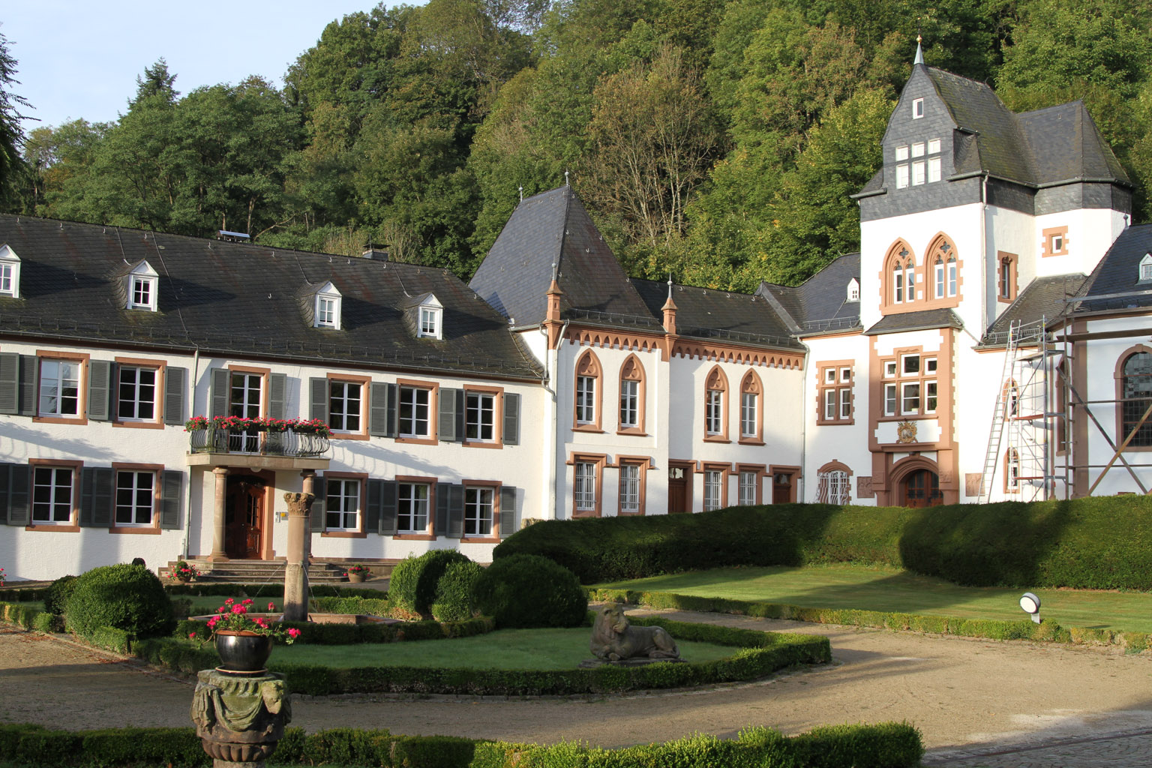

Slide 2


Slide 3
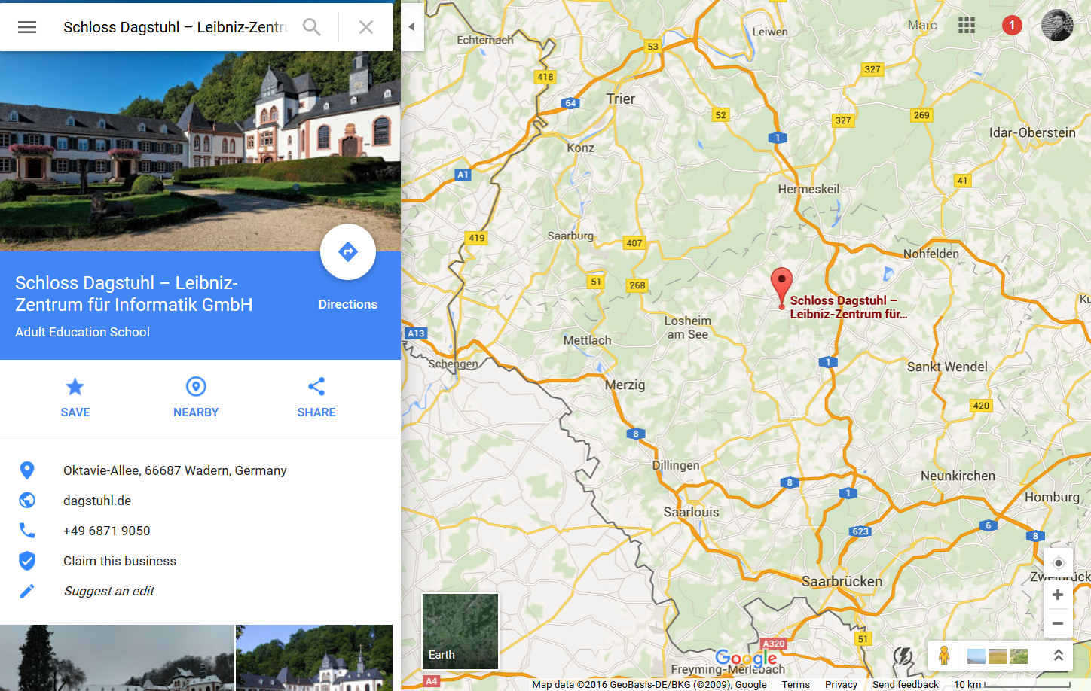

Slide 4
Trajectory Data: Analysis and Patterns
Pattern Recognition 2015/2016

Slide 5
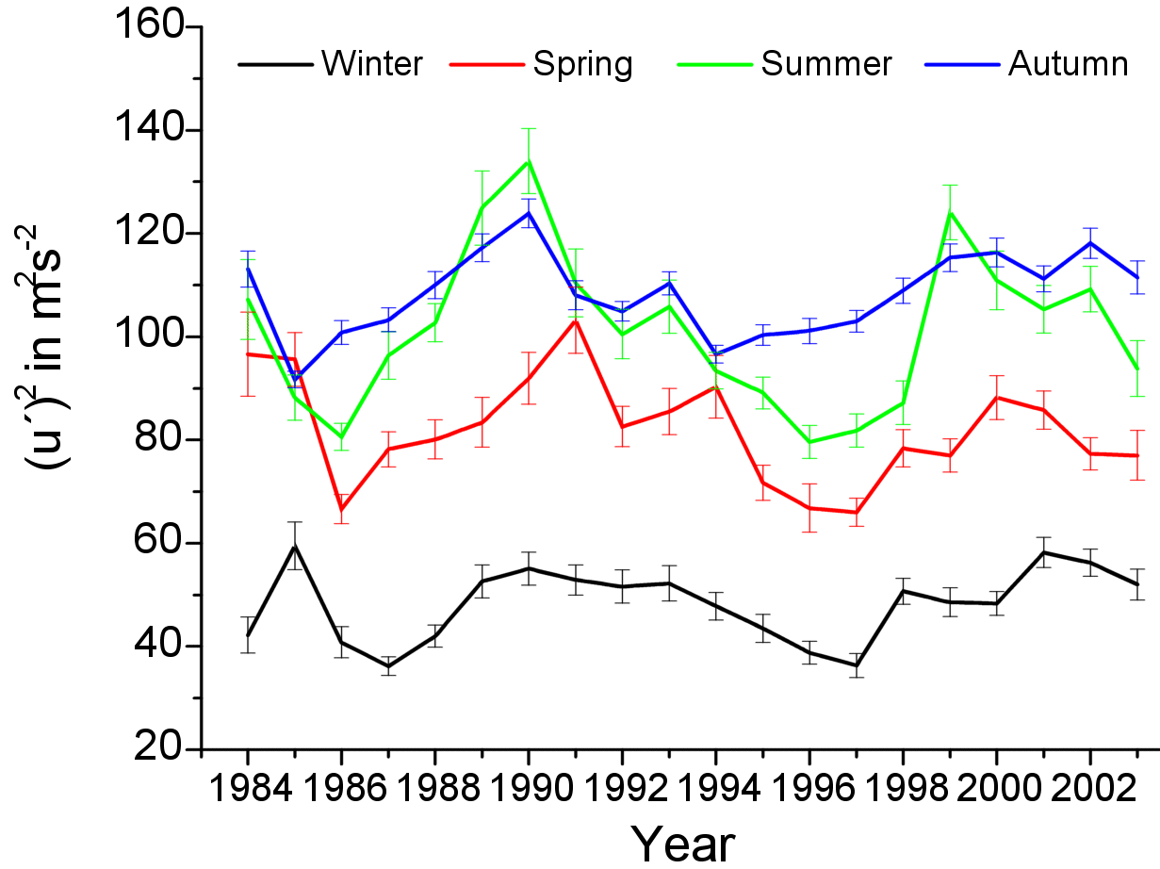
Algorithms Operate on Data
Tasks (scheduling)
Graphs (path planning, flow)
Numbers for math problems (prime testing, partition)
Linear inequalities (optimization)
Time series (data mining: trends, outliers)

Slide 6
Trajectories
Model for the movement of a (point) object; the model: f : [ time interval ] → 2D or 3D

Slide 7
Trajectories
Model for the movement of a (point) object; the model: f : [ time interval ] → 2D or 3D
The path of a trajectory is just any curve

Slide 8
Trajectories
Model for the movement of a (point) object
Many useful applications in different disciplines (including the real World)

Slide 9
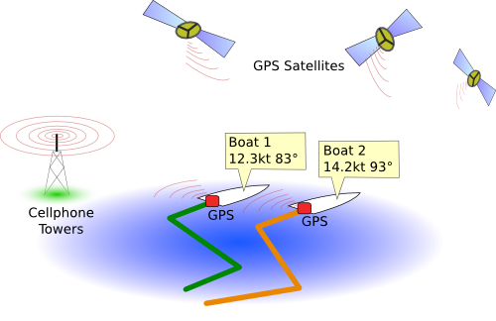
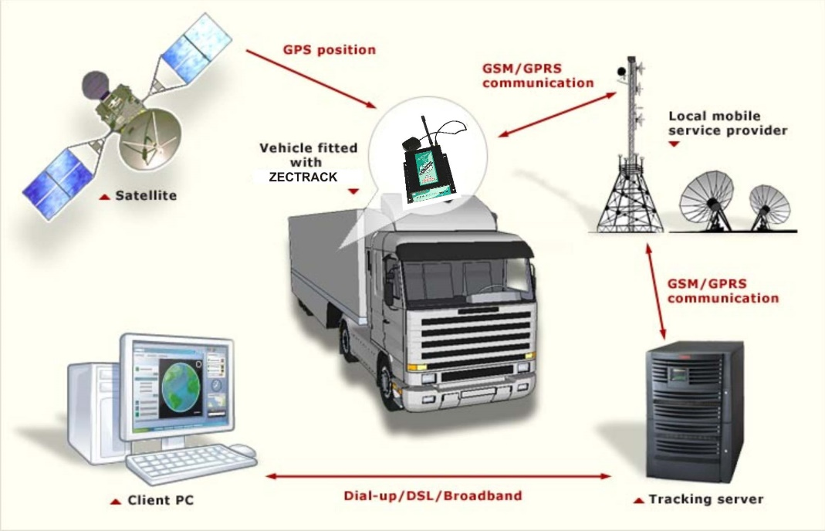
Tracking Vehicles

Slide 10

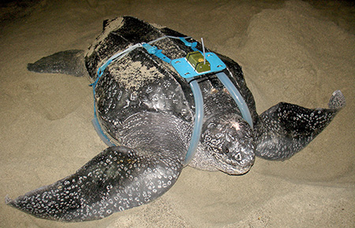
Tracking Animals

Slide 11
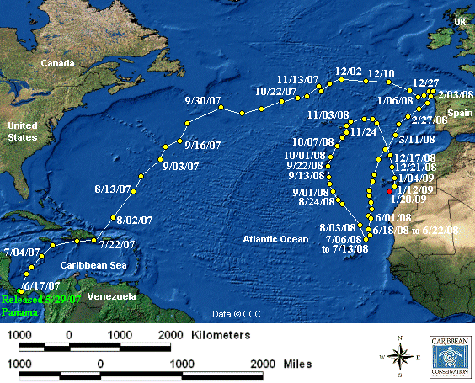
Tracked Turtle

Slide 12
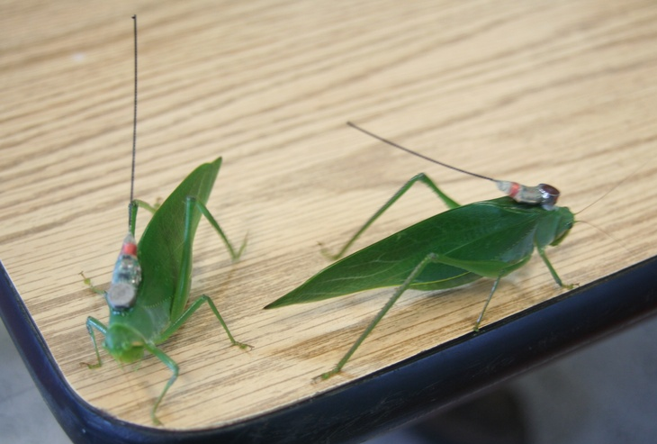
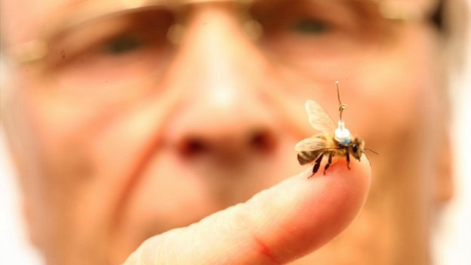
Tracking Insects

Slide 13
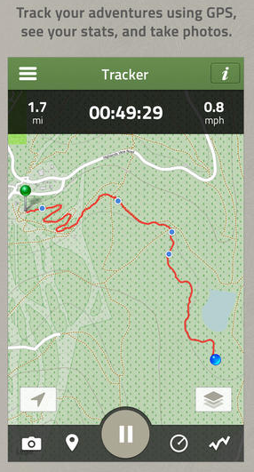

Tracking People

Slide 14
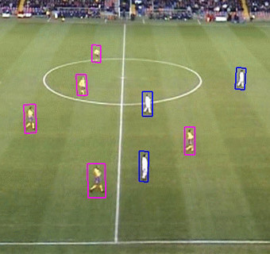
Tracking Sports Players

Slide 15
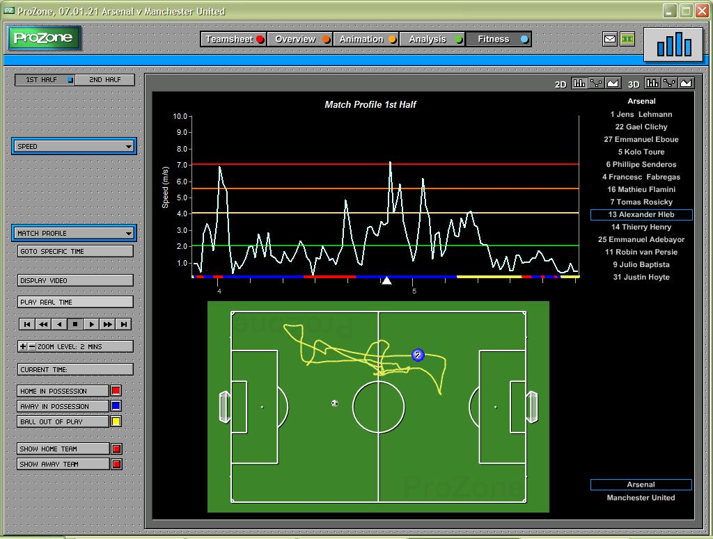
Tracking Sports Players

Slide 16
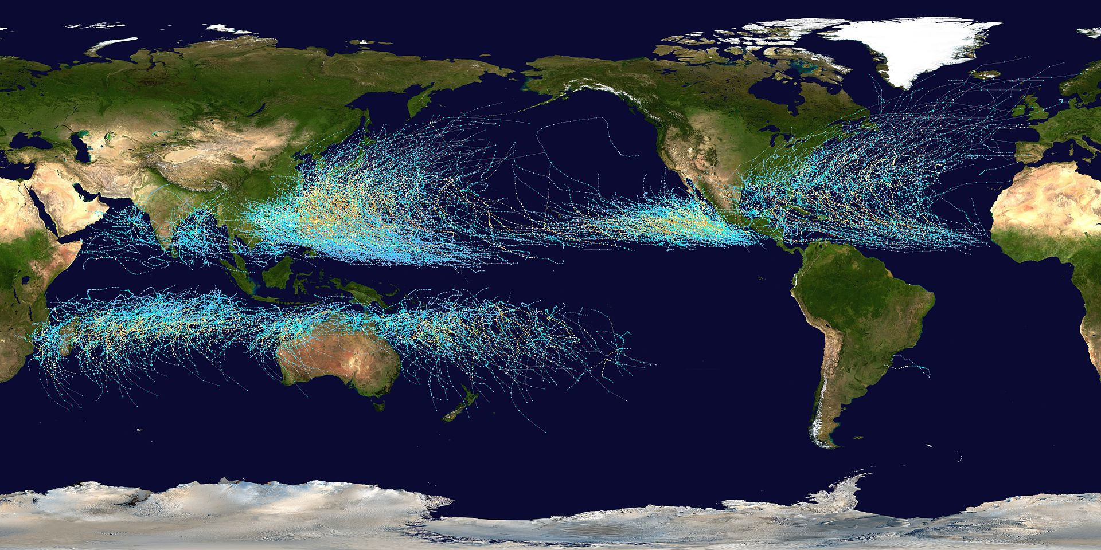
Tracking Hurricanes

Slide 17
Tracking Technology
GPS, RFID, video analysis, …
Range
Precision
Sampling rate

Slide 18
Tracking Technology
GPS
Range
Precision
Sampling rate

Slide 19
Tracking Technology
GPS
Range: whole world
Precision: 2-10 meters in lat-lon, worse in elevation Suffers from urban canyons, tree cover, clouds, …
Sampling rate: depends on device, energy source, need not be regular
Notes:
Typical outdoor GPS 5 samples/sec, smartphones 1 sample/sec, gulls with solar cell 1 sample/minutes

Slide 20
Trajectory Data
The data as it is acquired by GPS: sequence of triples (spatial plus time-stamp); quadruples for trajectories in 3D
(x_{n},y_{n},t_{n})
(x₂,y₂,t₂)
(x_{i},y_{i},t_{i})
(x₁,y₁,t₁)

Slide 21
Trajectory Data
Typical assumption for sufficiently densely sampled data: constant velocity between consecutive samples → velocity/speed is a piecewise constant function
(x_{n},y_{n},t_{n})
(x₂,y₂,t₂)
(x_{i},y_{i},t_{i})
(x₁,y₁,t₁)

Slide 22
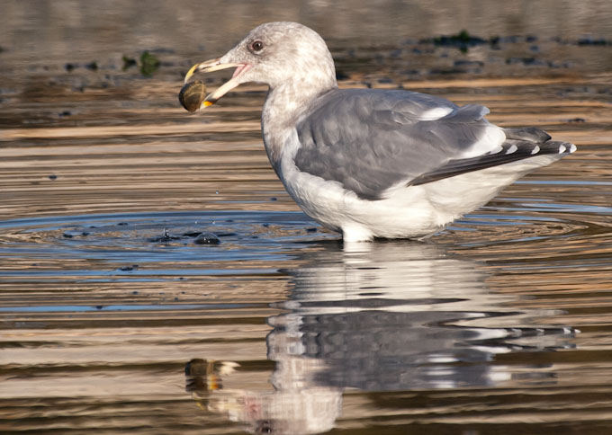
Trajectory Data Analysis
Address practical questions like: “How much time does a gull typically spend foraging on a trip from the colony and back?”

Slide 23

Trajectory Data Analysis
Address practical questions like: “How much time does a gull typically spend foraging on a trip from the colony and back?” “If customers look at book display X, do they more often than average also go to and look at bookshelf Y?”

Slide 24
Trajectory Data Analysis
Address practical questions like: “How much time does a gull typically spend foraging on a trip from the colony and back?” “If customers look at book display X, do they more often than average also go to and look at bookshelf Y?” “How and where is the change of direction in a starling flock initiated?”

Slide 25
Trajectory Data Analysis
Abstract/general purpose questions:
Single trajectory
simplification, cleaning
segmentation into semantically meaningful parts
finding recurring patterns (repeated subtrajectories)
Two trajectories
similarity computation
subtrajectory similarity
Multiple trajectories
clustering, outliers
flocking/grouping pattern detection
finding a typical trajectory or computing a mean/median trajectory
visualization

Slide 26
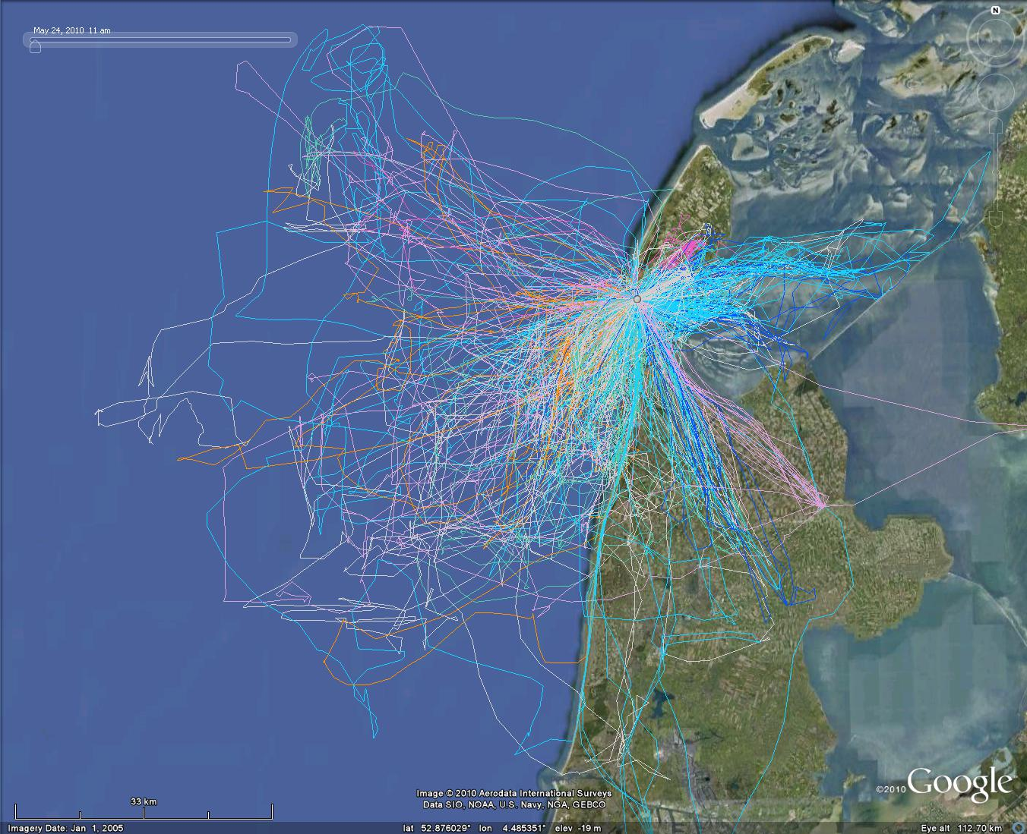

Slide 27
Trajectory Analysis
Research discussed here:
Segmentation of trajectories
Subtrajectory similarity
Trajectory grouping structure

Slide 28

Segmentation
Cutting a trajectory in pieces that are “similar” within the piece

Slide 29
Segmentation
Cutting a trajectory in pieces that are “similar” within the piece

Slide 30
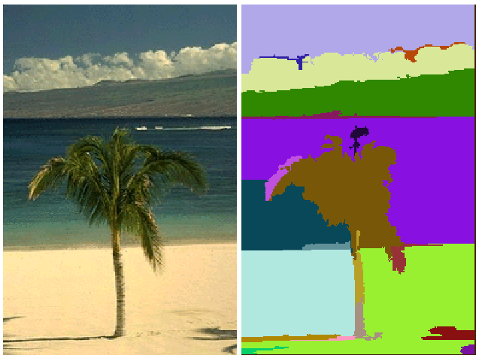
Segmentation in other Areas
Image segmentation: partition a digital image in parts with similar characteristics (hopefully meaningful pieces)

Slide 31
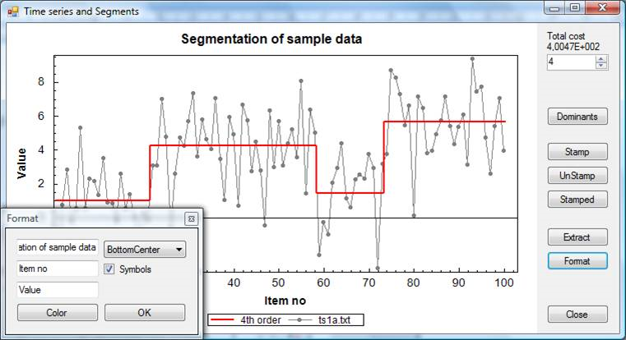
Segmentation in other Areas
Time-series segmentation: partition time series data into pieces with similar characteristics

Slide 32
Segmentation
Cutting a trajectory in pieces that are “similar” within the piece

Slide 33
Why Segmentation?
Explaining behavior of a moving entity: one type of behavior may be characterized by similarity of movement → semantic annotation
Detecting outliers: short segments in a segmentation may be caused by outliers

Slide 34
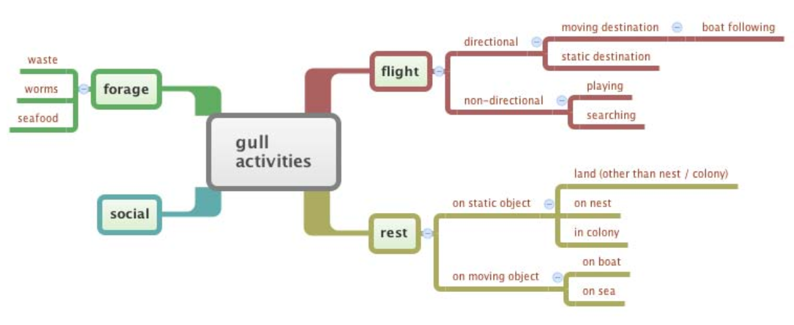
Why Segmentation?
Explaining behavior of a moving entity: one type of behavior may be characterized by similarity of movement → semantic annotation
Dagstuhl seminar: Representation, Analysis, and Visualization of Moving Objects (2010); break-out group : Gull data (Emiel van Loon, Jörg-Rüdiger Sack, Kevin Buchin, Maike Buchin, Mark de Berg, MvK, Joachim Gudmundsson, David Mountain)

Slide 35
Segmentation
Cutting a trajectory in pieces that are “similar” within the piece
“Similar” can refer to heading, speed, curvature, sinuosity, …
We want few pieces (no over-segmentation)
How do we define “similar”?

Slide 36
Segmentation: heading
On every edge of the trajectory, heading is well-defined
Similarity can mean: in the same cardinal direction
Northbound
West
East
South

Slide 37
Segmentation: heading
On every edge of the trajectory, heading is well-defined
Similarity can mean: in the same cardinal direction
Northbound
eastbound
westbound
West
East
northbound
South
southbound
eastbound

Slide 38
Segmentation: heading
On every edge of the trajectory, heading is well-defined
Similarity can mean: in the same cardinal direction
Northbound
West
East
South

Slide 39
Segmentation: heading
On every edge of the trajectory, heading is well-defined
Similarity can mean: in the same cardinal direction
Northbound
bad idea
West
East
South
We would segment at every vertex, while we want one single segment

Slide 40
Segmentation: heading
Use relative directions: We require that within any single segment the headings are within an angle π/2 everywhere

Slide 41
Segmentation: heading
Use relative directions: We require that within any single segment the headings are within an angle π/2 everywhere

Slide 42
Segmentation: heading
Use relative directions: We require that within any single segment the headings are within an angle π/2 everywhere

Slide 43
Segmentation: heading
Use relative directions: We require that within any single segment the headings are within an angle π/2 everywhere

Slide 44
Segmentation: heading
Use relative directions: We require that within any single segment the headings are within an angle π/2 everywhere

Slide 45
Segmentation: speed
Linear interpolation of position between the vertices makes speed piecewise constant (constant on every edge)
Segmentation can be based on absolute intervals like [0-2], [2-5], [5-10], [10-15], [15-20], [20-30], [30-..] km/h
31
29
31
29
31
29
31
29

Slide 46
Segmentation: speed
Linear interpolation of position between the vertices makes speed piecewise constant (constant on every edge)
Segmentation can be based on absolute intervals like [0-2], [2-5], [5-10], [10-15], [15-20], [20-30], [30-..] km/h
Segmentation can also be based on relative speeds: within any single segment the speed ratio is at most, say, 1.5 (alternatively: the speed difference is at most 10 km/h)

Slide 47
Segmentation: conjunction
Suppose we require that within any single segment:
the headings are within an angle π/2 everywhere, and
the speed ratio is at most 2

Slide 48
Segmentation: heading and speed
Suppose we require that within any single segment:
the headings are within an angle π/2 everywhere, and
the speed ratio is at most 2
speed
speed
speed
heading

Slide 49
Segmentation: heading and speed
Combining the optimal segmentations on heading and on speed is not optimal for the combined criterion
heading
speed

Slide 50
Segmentation
In all three cases (heading, speed, heading&speed), a greedy approach works: make each next segment as long as possible
Trivial from the algorithms perspective: O(n) time for a trajectory with n vertices
need to compare with and update the extreme headings (or speeds)

Slide 51
Segmentation: location
Segmentation on location: segment must fit inside some (well-placed) circle of a given radius, also greedy
Segmentation may happen between vertices
Less easy from the algorithmic perspective: O(n log n) time for a trajectory with n vertices (involves an LP-type problem)

Slide 52
Segmentation: attributes
Heading, speed and location are examples of attributes that are defined at (almost) every point on the trajectory
There are more criteria, like curvature, sinuosity, and curviness
→ need a framework to handle different criteria and different ways of combining them

Slide 53
Segmentation: framework
Attribute: some value defined at every point on the trajectory (location, heading, speed, curvature, …)
Criterion: restriction on allowed values of an attribute within the same segment (speed ratio at most 2, change of heading at most 3, etc.)
Segmentation on any combination (conjunction or disjunction) of criteria

Slide 54
Segmentation: framework
Attributes
Criteria
Segmentation on any combination:
Criteria satisfied within each segment
Optimal (minimum number of segments)

Slide 55
Segmentation: monotonicity
Definition: A criterion is monotone if satisfaction for a segment implies satisfaction for any subsegment
√ implies √
Absolute or relative heading is monotone
Absolute or relative speed is monotone
Location by enclosing circle or by diameter is monotone
Curvature criteria are monotone
Curviness, sinuosity also

Slide 56
Segmentation: monotonicity
Definition: A criterion is monotone if satisfaction for a segment implies satisfaction for any subsegment
Theorem: For any monotone criteria, if a subtrajectory with m vertices can be tested in O(T(m)) time and the furthest point satisfying the criteria on a given edge can be found in O(F(m)) time, then optimal segmentation takes O(T(n) log n + F(n)) time For the given criteria: optimal segmentation in O(n) or O(n log n) time

Slide 57
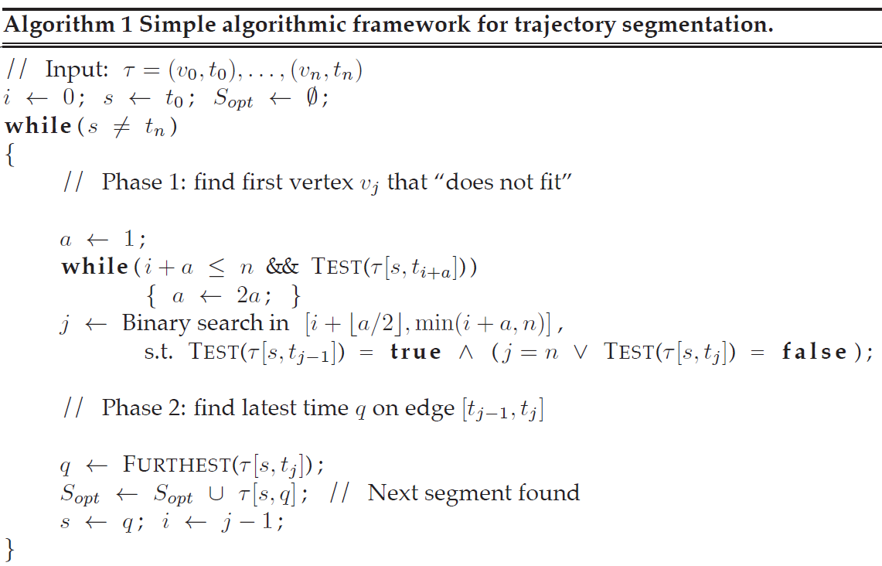
Segmentation: Algorithm

Slide 58
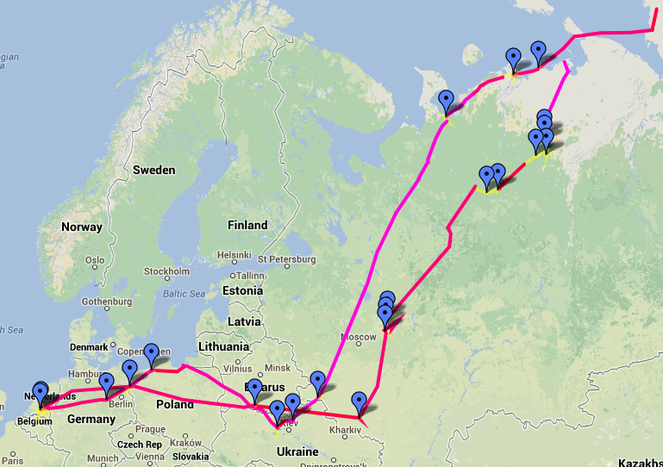
Migrating geese
Alewijnse, Buchin, Buchin, Kölzsch, Kruckenberg, Westenberg (2014)

Slide 59
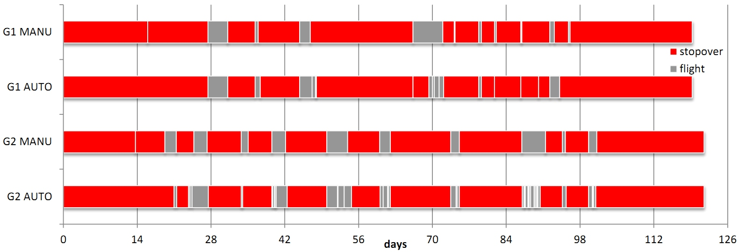
Migrating geese
Alewijnse, Buchin, Buchin, Kölzsch, Kruckenberg, Westenberg (2014)

Slide 60
How about non-monotone criteria?

Slide 61
Non-monotone Segmentation
Non-monotone criteria:
standard deviation (of e.g. speed) below a threshold
at most 5% of the time outlying speed (not within factor 1.5)
5 m/s
3 m/s
2 m/s
2 m/s
3 m/s
3 m/s
standard deviation ≤ 1 m/s

Slide 62
Non-monotone Segmentation
Non-monotone criteria:
standard deviation (of e.g. speed) below a threshold
at most 5% of the time outlying speed (not within factor 1.5)
possible
segments
(time intervals)
stop
(time)
b
b
a
a
start
(time)

Slide 63
Non-monotone Segmentation
Non-monotone criteria:
standard deviation (of e.g. speed) below a threshold
at most 5% of the time outlying speed (not within factor 1.5)
segmentation
stop
start

Slide 64
Non-monotone Segmentation
Non-monotone criteria:
standard deviation (of e.g. speed) below a threshold
at most 5% of the time outlying speed (not within factor 1.5)
forbidden segments
stop
start

Slide 65
Non-monotone Segmentation
Non-monotone criteria:
standard deviation (of e.g. speed) below a threshold
at most 5% of the time outlying speed (not within factor 1.5)
forbidden segments
stop
start

Slide 66
Non-monotone Segmentation
Non-monotone criteria:
standard deviation (of e.g. speed) below a threshold
at most 5% of the time outlying speed (not within factor 1.5)
forbidden segments for monotone criteria
stop
start

Slide 67
Non-monotone Segmentation
Abstract minimum staircases, any forbidden regions with n edges → NP-hard

Slide 68
Non-monotone Segmentation
When forbidden regions come from our non-monotone criteria on trajectories, the minimum staircase problem can be solved in polynomial time
stop
start

Slide 69
Non-monotone Segmentation
When forbidden regions come from our non-monotone criteria on trajectories, the minimum staircase problem can be solved in polynomial time
stop
start

Slide 70
Non-monotone Segmentation
For the outlier criterion, the forbidden region in a single cell is always the common intersection of at most four half-planes

Slide 71
Non-monotone Segmentation
Compute the forbidden region in each of the O(n²) cells of the start-stop diagram
Starting at k = 1, compute what can be reached in k steps using what can be reached in k – 1 steps and increment k
When we reach the end of the trajectory, finish

Slide 72
Non-monotone Segmentation
Non-monotone criteria:
standard deviation (of e.g. speed) below a threshold
at most 5% of the time outlying speed
Segmentation on these criteria takes O(k n² ) or O(k n² log n) time, where k is the optimal number of segments
For certain non-monotone criteria, no efficient algorithm seems to exist (e.g. conjunctions)

Slide 73
Topic 2: subtrajectory similarity

Slide 74
Similarity of trajectories
Inverse of “distance”
Important for clustering
Various measures possible

Slide 75
Similarity of trajectories
Inverse of “distance”
Important for clustering
Various measures possible
Hausdorff: maximum
of some point on one
trajectory to nearest
point on other trajectory

Slide 76
Similarity of trajectories
Inverse of “distance”
Important for clustering
Various measures possible
Frechet: minimum leash
length for a child and dog
to traverse the whole
trajectory, without going back (child nor dog)

Slide 77
Hausdorff distance and Frechet distance are
measures for shapes, not for trajectories

Slide 78
Similarity of trajectories
Inverse of “distance”
Important for clustering
Various measures possible
Time-aware: maximum distance for pairs of points at the same time

Slide 79
Similarity of trajectories
Inverse of “distance”
Important for clustering
Various measures possible
Average time-aware: average distance over all pairs of points at the same time

Slide 80
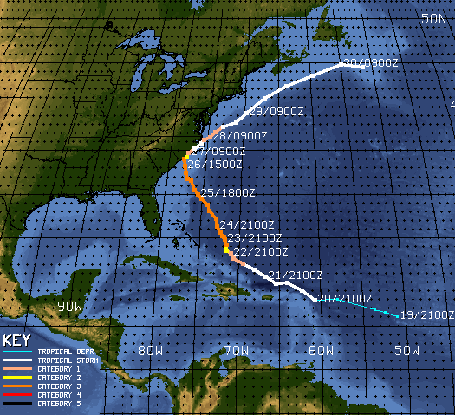
Why sub-trajectory similarity?
The start behavior of an entity/trajectory may be a-typical (animal just after giving it a radio collar)
The start of a phenomenon may be gradual (hurricane builds up in force)

Slide 81
Similarity of sub-trajectories

Slide 82
Similarity of sub-trajectories

Slide 83
Average time-aware distance
τ₁(t) is the position of entity 1 at time t
τ₂(t + t_{shift}) is the position of entity 2 at time t + t_{shift}
t_{s} is the start time; T is the duration

Slide 84
Subtrajectory similarity
Simplest version: same starting times of subtrajectory (but unknown), duration T given, can be solved in linear time
Idea: increase t_{s} to perform a scan over the trajectories
minimize with fixed T

Slide 85
Subtrajectory similarity
The problem becomes: Find t_{s} such that the area below the graph from t_{s} to t_{s}+T is minimum
Between two endpoints, the graph is a hyperbolic function
d(τ₁(t), τ₂(t))
t_{s}
t_{s}+T
t

Slide 86
Subtrajectory similarity
Updating the area function (expressed in t_{s} ) below the graph when t_{s} to t_{s}+T passes an endpoint can be done in O(1) time, optimizing the function too
The scan takes O(n) time in total
d(τ₁(t), τ₂(t))
t_{s}
t_{s}+T
t

Slide 87
Trajectory similarity and clustering
With a similarity measure for trajectories, certain clustering methods are directly applicable:
single linkage clustering
complete linkage clustering
(if we can identify a representative) k-medoids clustering
(if we can identify a mean) k-means clustering
For single linkage and complete linkage clustering, compute a matrix with all (n choose 2) similarity measures
Start with singleton clusters and merge the “closest two” iteratively, until k clusters remain

Slide 88
Topic 3: grouping structure

Slide 89

Grouping Structure
How does one define and compute the ensemble of moving entities forming groups, merging with other groups, splitting into subgroups?
… define and compute … ➔ formalization + algorithms

Slide 90
Previous Work
Flocks [Gudmundsson, Laube, Wolle, Speckmann, …. (2005- )]
Herds [Huang, Chen, Dong (2008)]
Convoys [Jeung, Yiu, Zhou, Jensen, Shen (2008); Aung, Tan (2010)]
Swarms [Li, Ding, Han, Kays (2010)]
Moving groups/clusters [Kalnis, Mamoulis, Bakiras (2005); Wang, Lim, Hwang (2008); Li, Ding, Han, Kays (2010)]
t=2
t=4
t=6
t=8
t=1
t=3
t=5
t=7

Slide 91
The Results
Use whole trajectory (interpolated) instead of discrete time stamps only (as opposed to herds, swarms, convoys, …)
Study the whole grouping structure with merging, splitting, … (as opposed to finding flocks)
Use a mathematically clean model
Complexity and efficiency analysis
Implementation and testing for plausibility
t=2
t=4
t=6
t=8
t=1
t=3
t=5
t=7

Slide 92
Grouping

Slide 93
Grouping

Slide 94
Grouping
Three criteria for a group:
big enough (size m)
close enough (inter-distance d)
long enough (duration δ)
Only maximal groups are relevant Otherwise, assuming m=4, if 8 entities form a group during δ (or longer), then also all 162 subgroups of size at least 4 during that same time interval (maximal in group size, starting time or ending time)

Slide 95
Grouping
Trace the connected components of moving disks whose radius is half the specified inter-distance, d/2

Slide 96
Grouping
Trace the connected components of moving disks whose radius is half the specified inter-distance, d/2
time
0
1
4
5
8
10

Slide 97
Grouping
Maximal groups (m=2, δ =3):
{ green, blue }: [0-4]
{ green, blue, red }: [1-4]
{ blue, red}: [1-5]
{ green, purple }: [8-10]
Maximal groups (m=3, δ =3):
{ green, blue, red }: [1-4]
Maximal groups (m=2, δ =4):
{ green, blue }: [0-4]
{ blue, red}: [1-5]

Slide 98
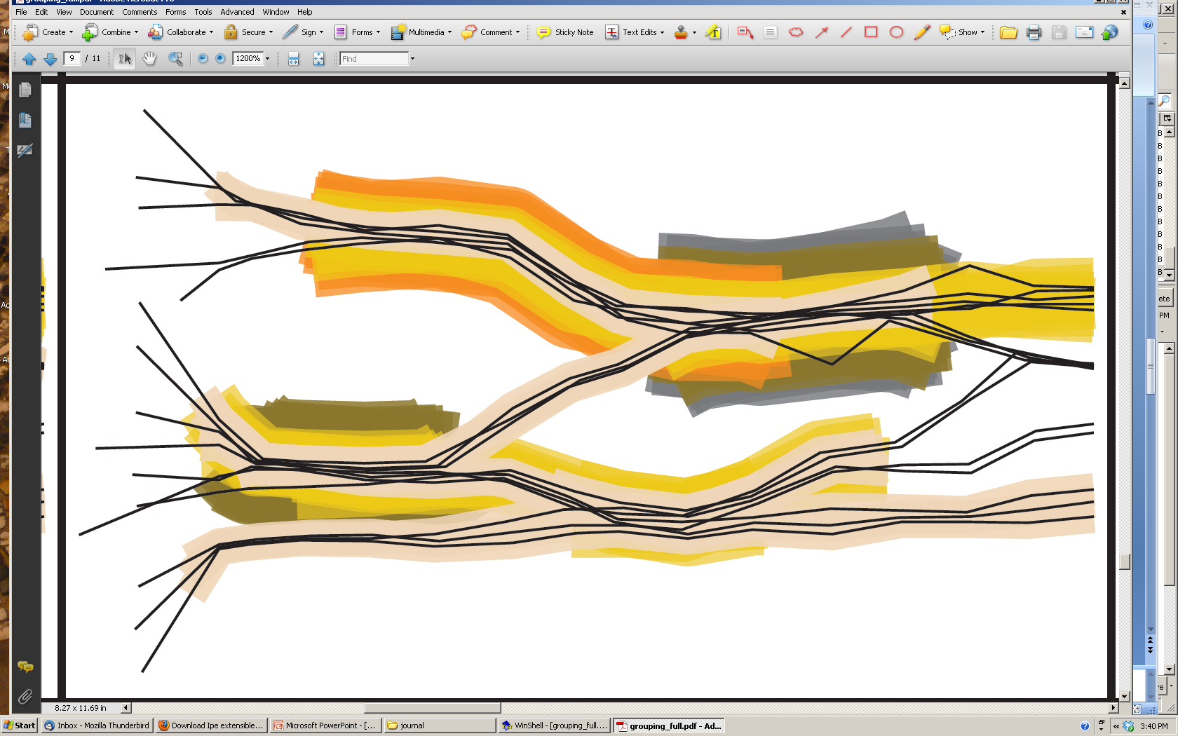
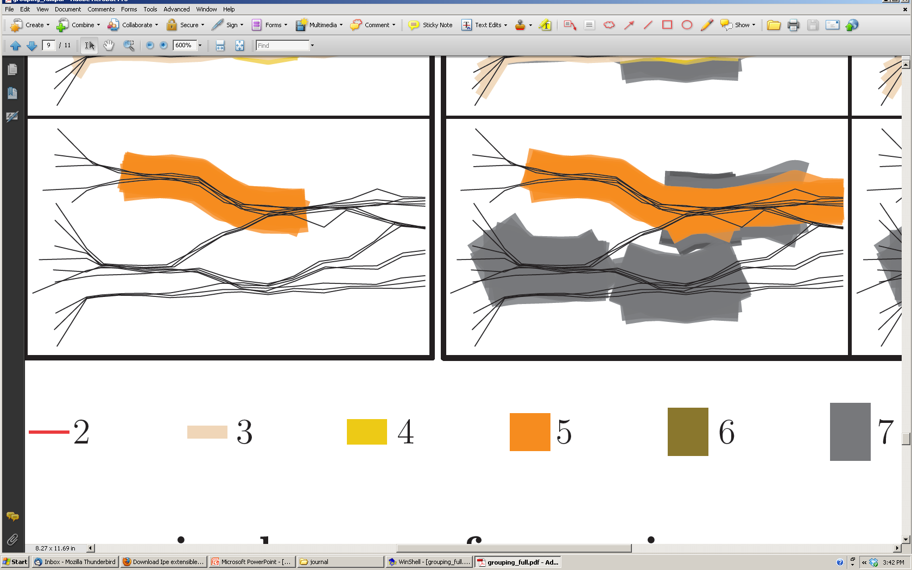
minimum group size 3
For illustration: x-coordinate is time

Slide 99
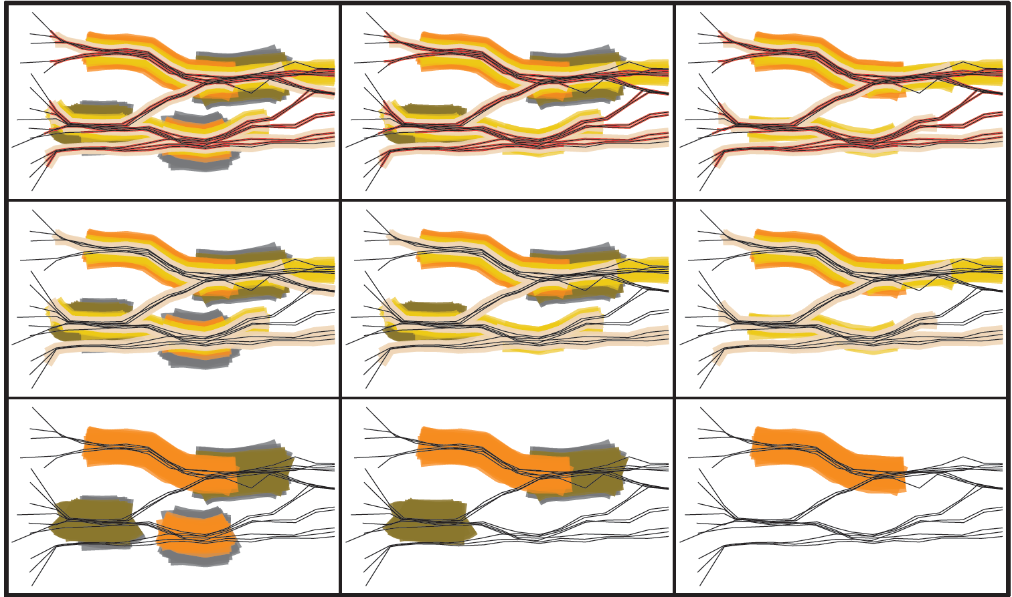

Slide 100
Grouping Structure
Reeb graph (from computational topology): structure that captures the changes in connectivity of a process, using a graph
Edges are connected components
Vertices are changes in connected components (events)
From 1 to 2 connected components

Slide 101
Grouping Structure
Reeb graph; disregard group size (m = 1) and duration (δ = 0)

Slide 102
Grouping Structure
Reeb graph; disregard group size (m = 1) and duration (δ = 0)
blue
t=10
t=0
blue, green
red, blue
red
t=10
red, blue, green
t=5
t=0
red
t=1
t=4
green
purple, green
purple
t=10
t=0
t=8
edges ~ connected components vertices ~ events (changes in connected components)

Slide 103
Computing the Grouping Structure
Assume t time steps and n entities
Assume piecewise-linear trajectories and constant speed on pieces
The Reeb graph has O(t n²) vertices and edges; this bound is tight in the worst case
Its computation takes O(t n² log n) time

Slide 104
Computing the Maximal Groups
Given a value for group size m and duration δ and distance:
Compute the Reeb graph using distance d
Annotate its edges and vertices
Process the vertices in time-order, maintaining known maximal groups
Filter the maximal groups (using m and δ)
blue
t=10
t=0
blue, green
red, blue
red
t=10
red, blue, green
t=5
t=0
red
t=1
t=4
green
purple, green
purple
t=10
t=0
t=8

Slide 105
Computing the Maximal Groups
Given a value for group size m and duration δ and distance:
Compute the Reeb graph using distance d
Annotate its edges and vertices
Process the vertices in time-order, maintaining known maximal groups
Filter the maximal groups (using m and δ)
No existing maximal group ends, the maximal groups of the two branches are joined and maintained with the new branch
One new maximal group starts and is maintained
merge

Slide 106
Computing the Maximal Groups
Given a value for group size m and duration δ and distance:
Compute the Reeb graph using distance d
Annotate its edges and vertices
Process the vertices in time-order, maintaining known maximal groups
Filter the maximal groups (using m and δ)
Any existing maximal group with at least one of each new component ends and is reported
New maximal groups can start on both branches; they are maintained
split

Slide 107
Computing the Maximal Groups
Processing a vertex takes linear time → computing all maximal groups costs O(t n³) time (plus output size)
There are at most O(t n³) maximal groups, this bound is tight in the worst case

Slide 108
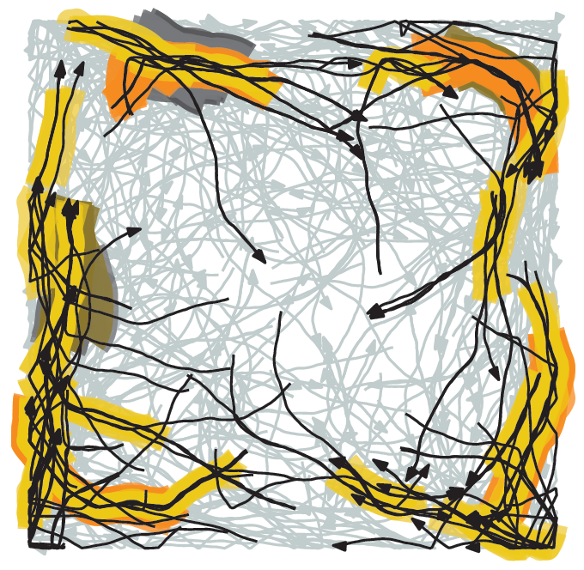
The Grouping Structure
A simple, clean model for grouping / moving flocks / …
Proofs of desirable properties
Algorithms for the computation of the grouping structure and the maximal groups, with efficiency bounds
Adaptations to get robust grouping
Plausible, based on implementation

Slide 109
Grouping in Environments
Extension: if distance should not be measured in a straight line, but geodesic amidst obstacles, what can we do?
wall
d
two groups

Slide 110
Research Trends
Algorithms for dealing with real data: filling in missing data, providing accuracy estimates, …
Detecting patterns that involve interaction between moving entities
Trajectory analysis incorporating other data (heart-rate, environment)
Proper visualization for various applications and situations
Algorithms, implementations and tests for specific, applied research questions (gap theory – application)

